Slide 1
PLAN SEQUENCING
Mac Cummins
Terry Cullen
August 6, 2018
Neighborhood Area Planning

Slide 2
PROCESS
Bellevue is a city of diverse neighborhoods, each with its own unique and distinct character.
Neighborhoods have a prominent place in the Comprehensive Plan:
-Neighborhoods Element
-Subarea Plans
Notes:
Welcome back to Neighborhood Area Planning. Continuing conversation.
Objective tonight is to discuss how neighborhood plans can be sequenced.
We will be asking Council to initiate plan amendments for 4 neighborhood area plans to be completed over the next 2 years.
Let’s re-group on where we’ve been so far.
In Study sessions on May 29 and July 9, Council:
Reviewed the proposed neighborhood area planning program;
Provided guidance on specific aspects of the program;
Directed staff to meet with neighborhood leaders to solicit their input (done June 12);
Received that input;
Directed staff to move forward with initiation of the program following a schedule of two plans per year; and
Then directed staff to develop criteria for sequencing neighborhood area plans.
And that brings us tonight. Let’s do a quick refresh on the process for those in our viewing audience who may be new to this.
The importance of neighborhoods to the City cannot be understated.
We have 16 neighborhood areas in the city each with a distinct and unique character.
For our purposes tonight, we haven’t included Bel Red or Downtown because they have their own separate planning programs.
Neighborhoods have a prominent place in the city’s premier policy document, the Comprehensive Plan. There is an element of the plan exclusively for neighborhoods and there are old subarea plans too.
*Note about subareas vs neighborhood areas.

Slide 3
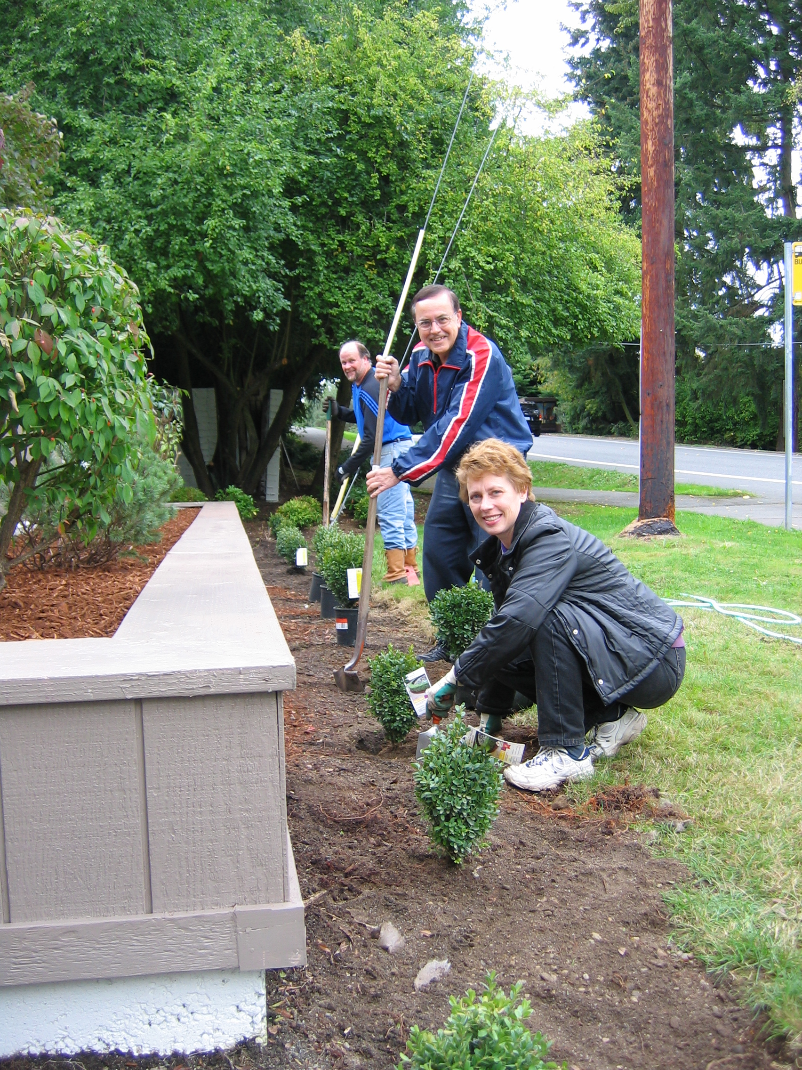
PROCESS
Neighborhood plans will be:
Based on the Comprehensive Plan
Strategic and action-focused
A ground-up community process
Notes:
The larger, city-wide comprehensive plan with its 13 topical elements is the primary plan that guides the city’s future growth and development. It meets state mandated Growth Management Act requirements. In days gone by, this would be referred to as the ‘primary plan’.
The neighborhood area plans are also housed in the comprehensive plan but in a 2nd volume of the plan. In days gone by, they would be referred to as ‘secondary plans’.
Neighborhood plans must be consistent with the larger, city-wide comprehensive plan, the primary plan.
Neighborhood plans won’t direct changes to the larger, city-wide comprehensive plan. That would circumvent the larger comprehensive plan updates that occur approximately every 10 years.

Slide 4
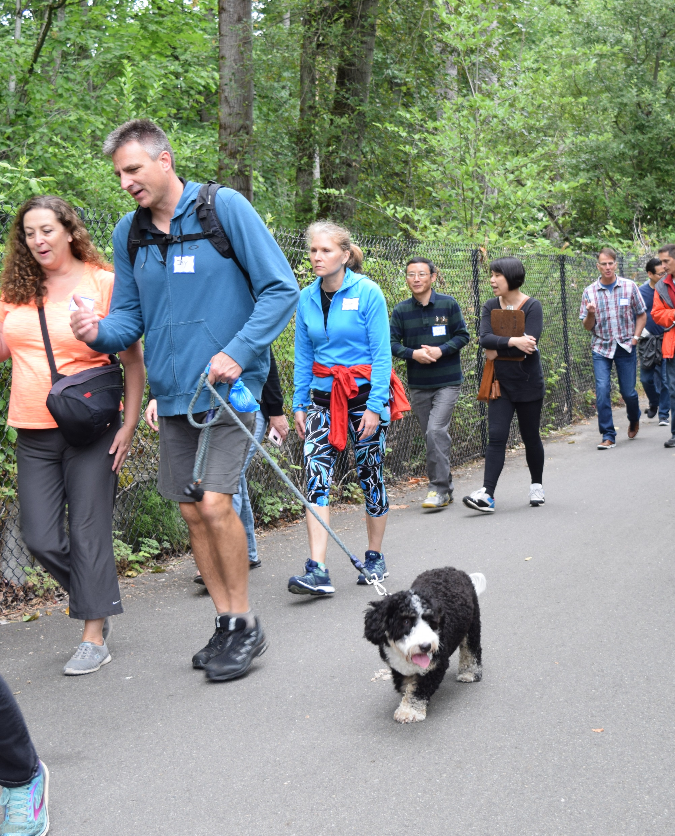
PROCESS
Throughout the process, residents will partner with the City to:
-Identify the unique and distinct character of their neighborhoods
-Envision and plan for their future
Notes:
Council directed staff to talk with neighborhood leaders and get feedback on the process.
A Neighborhood Leaders meeting was held on June 12 and that feedback was reported back to you on July 9.

Slide 5
Notes:
We included an easier to understand timeline that we will use for general information and education purposes.
Generally, it follows the school calendar.
We noted Council’s interest that the final review by Council not be held during the summer months.
Note that the original Attachment B in the agenda packet has the wrong months listed for Phase 4. The slide on the screen is correct. Phase 3 (April-June); Phase 4 (September-December).

Slide 6
PROCESS
Each Neighborhood Area Plan will include:
-A community profile
-A neighborhood opportunities map
-Its relationship to the larger Comprehensive Plan
-Vision, goals and strategies
Notes:
Refer directly to the slide

Slide 7
TENETS
Be on the ground, in the neighborhoods.
Listen to the community.
Have a conversation with the community.
Understand the community.
Organic and home grown is important.
Notes:
These are important tenets, or beliefs, that are important to how we engage with our communities.

Slide 8
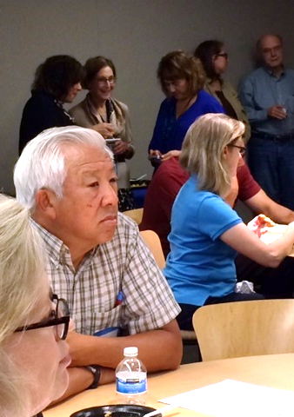
PROCESS
New plans will have:
-Key priorities and initiatives
-Neighborhood-based actions to help support neighborhood and citywide priorities
-Updated information to inform Comprehensive Plan updates
-A strong sense of ownership
Notes:
No additional notes. Work from the slide.

Slide 9
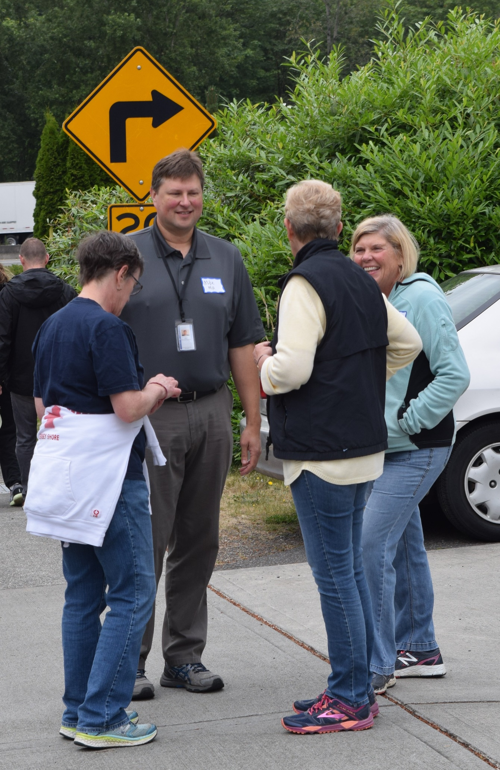
THE NEXT STEP
Every neighborhood is impacted by internal and external changes:
-Increases in traffic
-Loss of tree canopy
-More and larger buildings
-Demographics
-Housing affordability
Notes:
Let’s go to the next step.
A lot of the change has been very good for us, but some of the impacts have been painful. We hear it. And we feel it too.
I’m a Bellevue resident and I’ve been here 2 ½ years. I think our cultural diversity is an amazing asset. Our parks are truly crown jewels in the city, and we have a spectacular downtown. Bellevue not only welcomes the world; Bellevue wows the world.
I have also been caught in the traffic jams. I’ve canceled plans because I couldn’t get from here to there. I’m in my 3rd year renting in Bellevue and I realize that I probably won’t be able to buy a home here because homes are so expensive. I feel the pain too.
These issues are much bigger than my neighborhood alone and a neighborhood plan can’t provide a remedy.

Slide 10
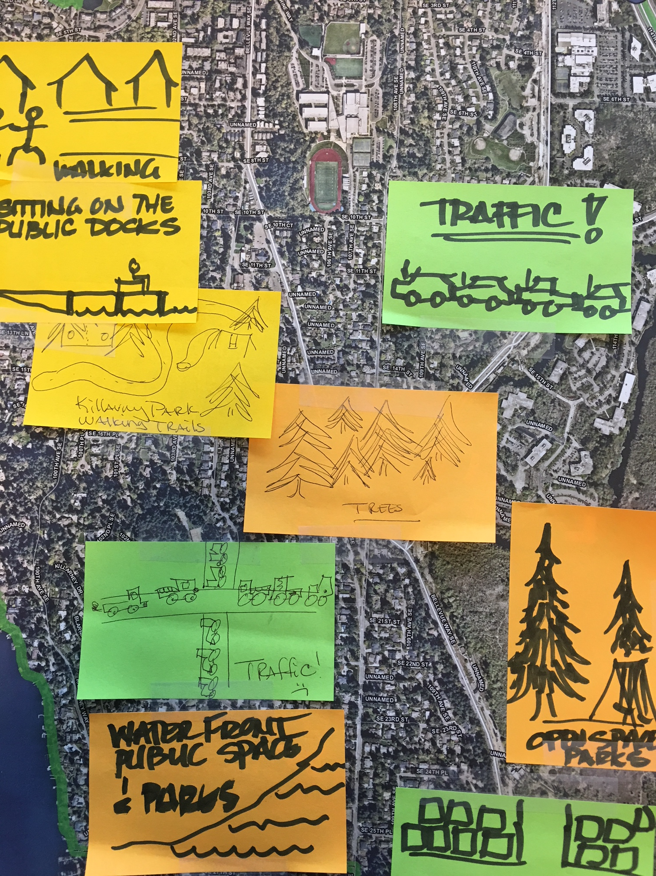
THE NEXT STEP
Every neighborhood area deserves a plan, and a plan will be done for every neighborhood area.
Two plans will be completed each year.
Notes:
Work directly from the slide.

Slide 11
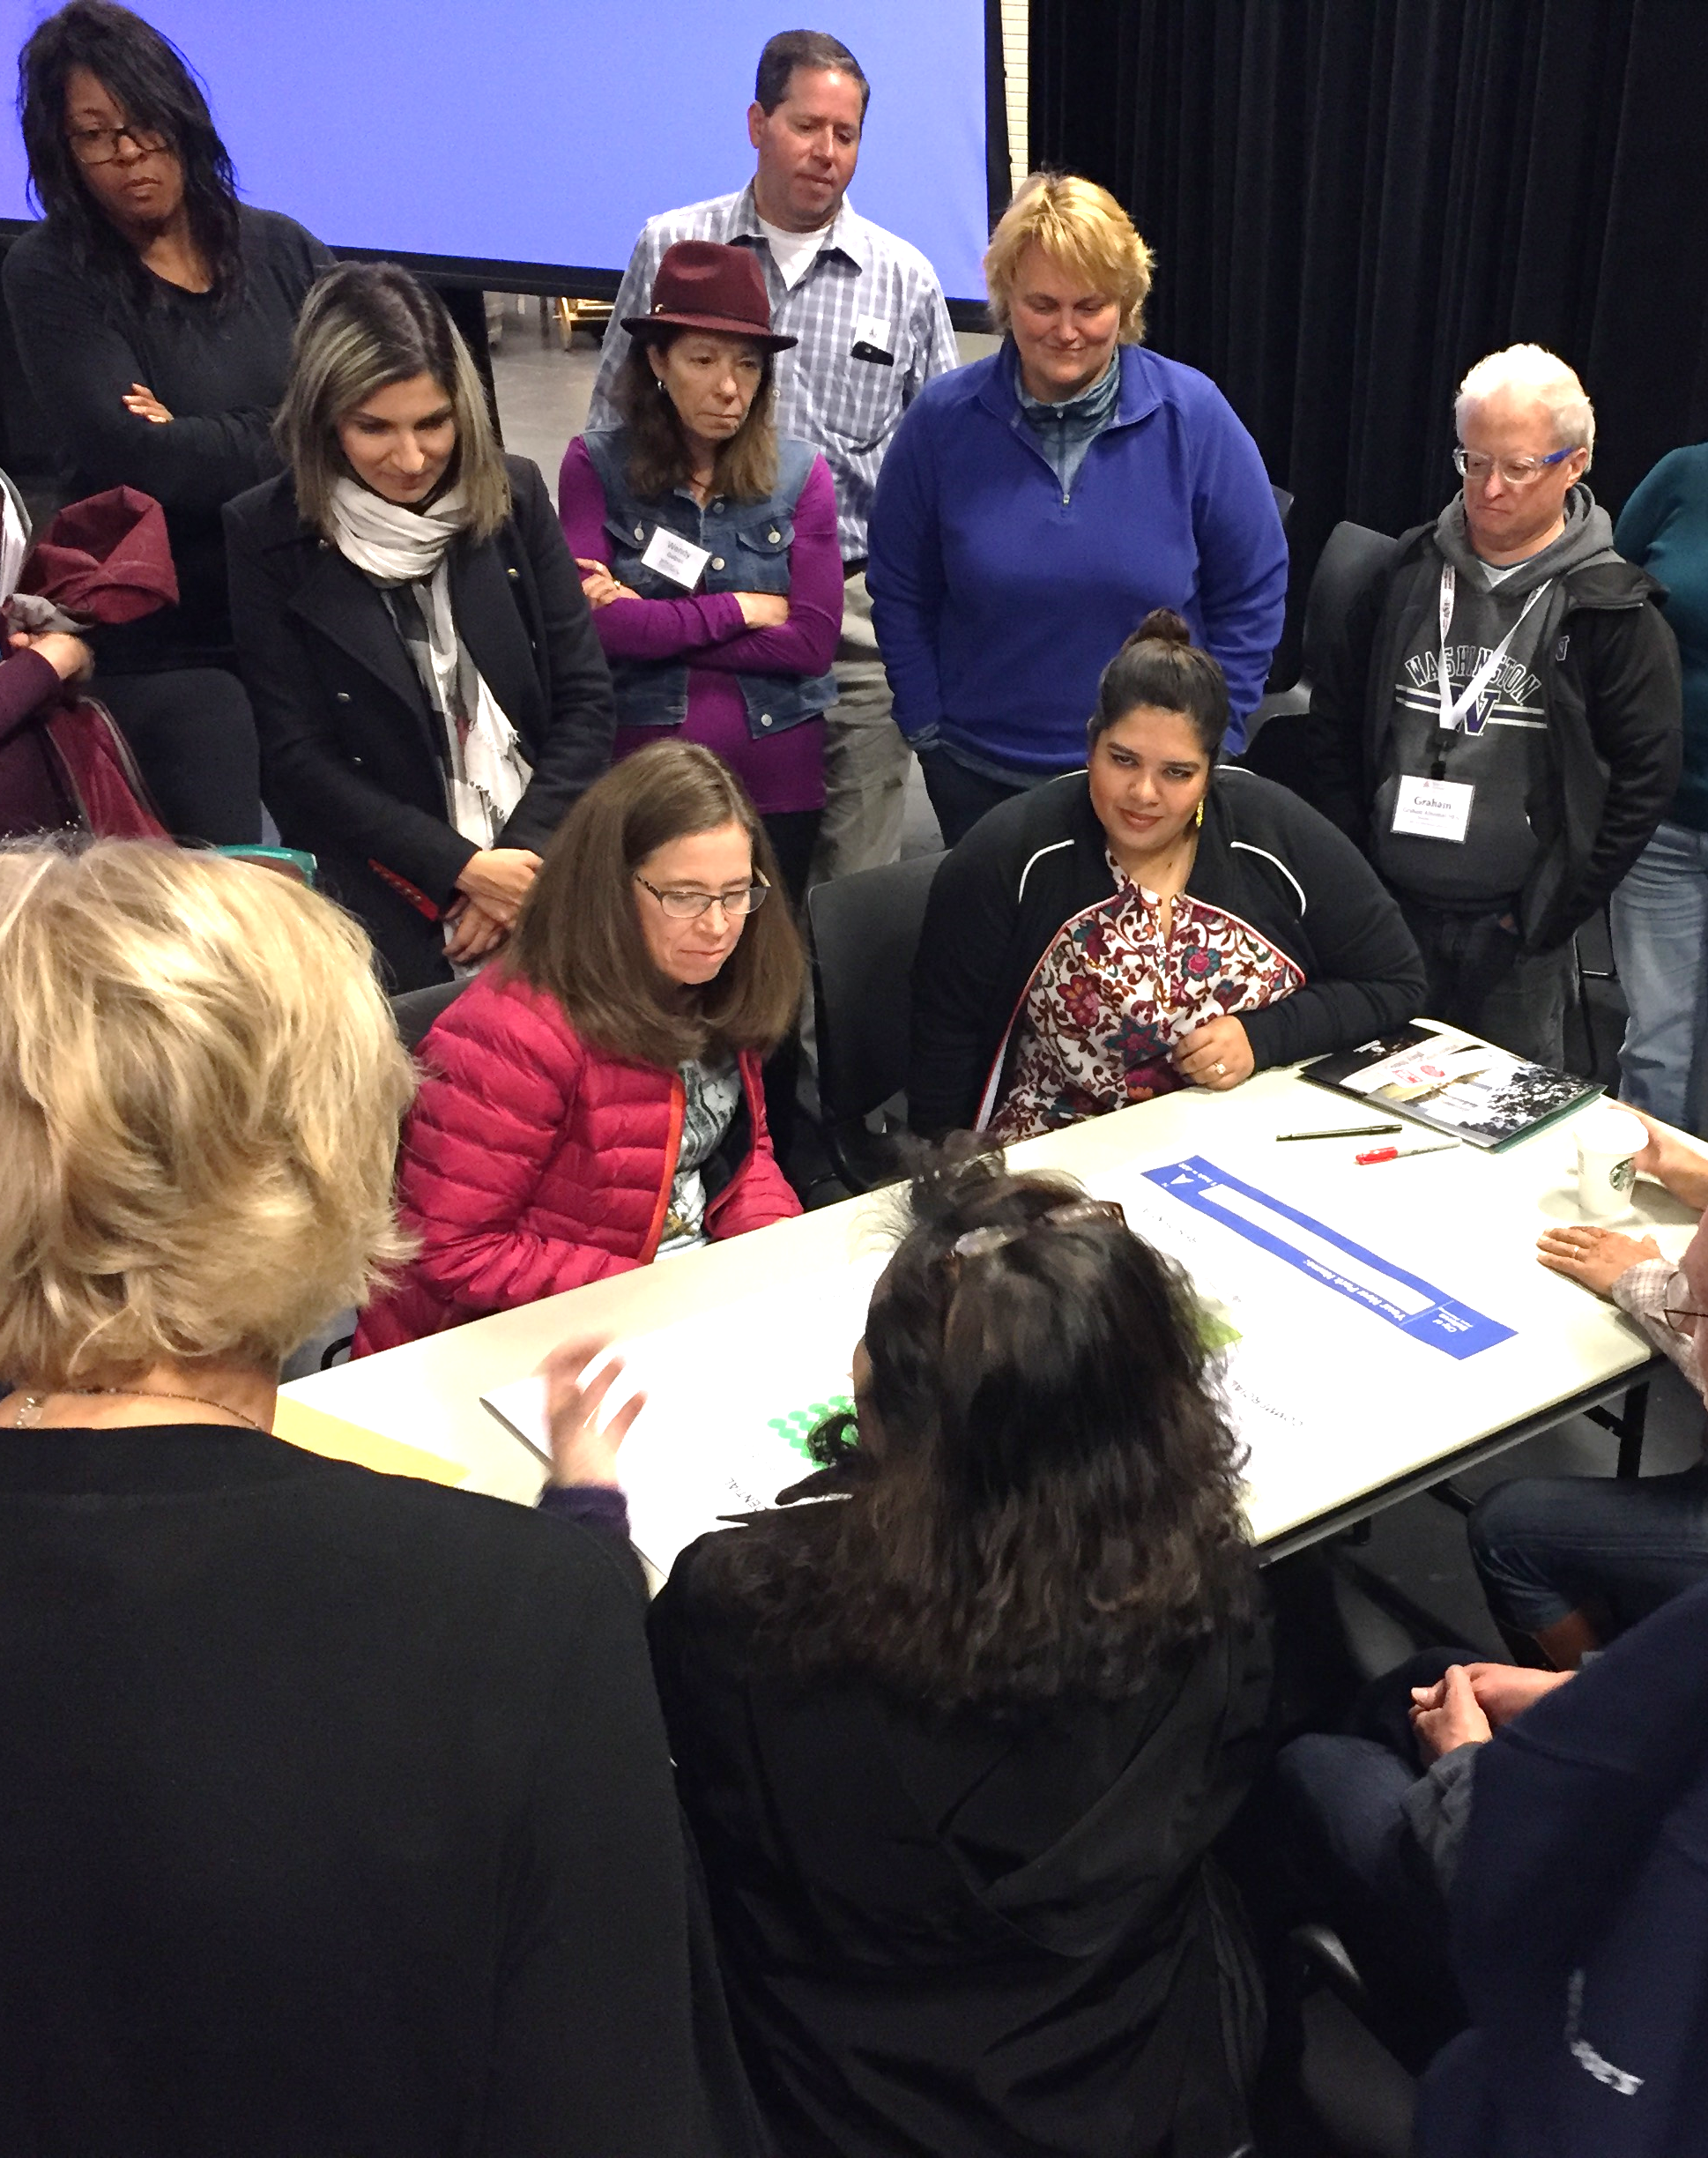
THE NEXT STEP – SEQUENCING
Choosing where to begin can be challenging:
Every neighborhood has its own unique circumstances.
Notes:
Comments from the Neighborhood Leaders Meeting June 12 about sequencing:
consider selecting two neighborhood areas with a shared boundary
consider selecting two neighborhood areas that are inherently dependent on each other
But
don’t lose distinct character of neighborhood area by grouping together and forcing solutions that don’t fit the neighborhood.
consider which neighborhood area is facing the most urgent issues

Slide 12
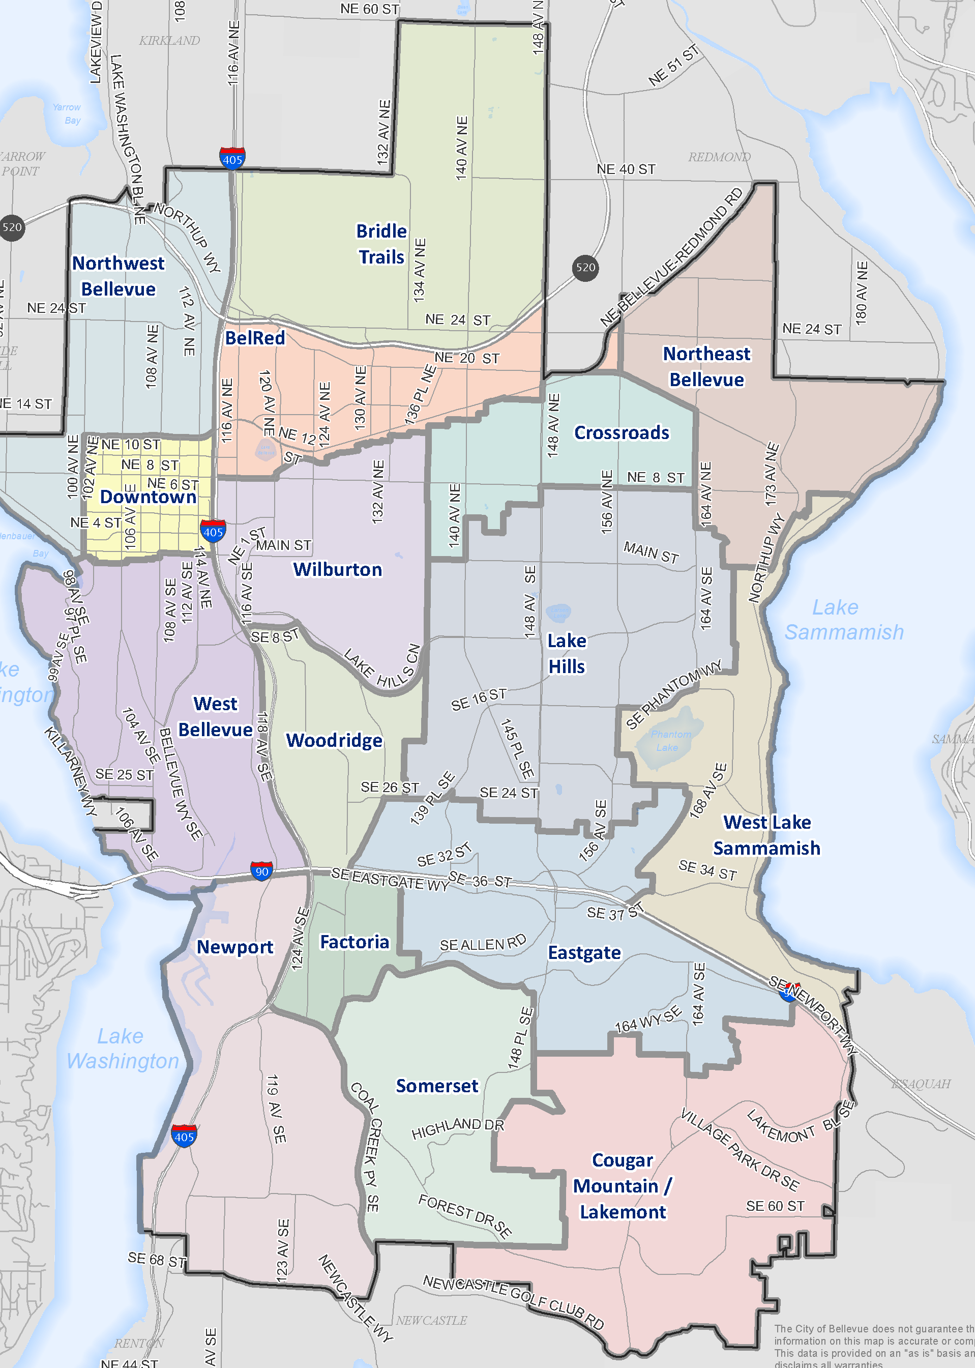
Plan Sequencing
Evaluation Criteria
Subarea plan age
Growth and development:
New single family residential permits
Undeveloped land; and
Infill development
New commercial & multi-family permits
Notes:
We purposely kept the evaluation criteria simple.
We chose these criteria because
Most of the plans are very outdated, some more than others. Some were created before the GMA.
Growth seems to be a proxy for so many other drivers of change in neighborhoods.
16 neighborhood areas
Two most recent updates are Downtown (2004) and BelRed (2009).
Downtown Livability land use code update completed in 2017
BelRed Lookback is planned to begin soon.
BelRed, Downtown are not included in the sequencing evaluation.
Review and update of the 14 older neighborhood area plans prior to the next review of Downtown and BelRed.

Slide 13
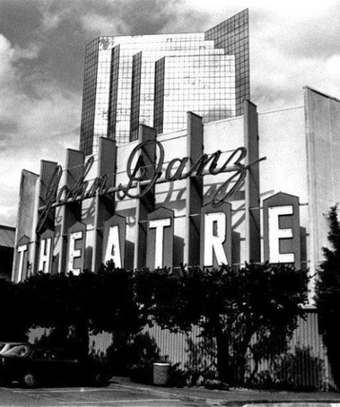
Subarea Plan Age
Based on date of adoption
Subarea plan that corresponds to neighborhood area
Some date back to mid-1980s
Most recent plans were completed in the mid-1990s
Notes:
Pop quiz. Who has the oldest neighborhood area plan?
Refer to Attachment D to reference the age of the plans.
Before advancing to next slide, ask ‘which neighborhood had the most new residences on undeveloped land?
Some of the adopted subarea plans date back to the mid-1980s, predating the Washington Growth Management Act, related implementing regulations and many existing city programs and capital investments. Key issues addressed in these older plans may no longer be pertinent and current emerging issues not be addressed at all. Plan age, based on original date of adoption, is measurable and readily available data
Overall, roughly half of the subarea plans were adopted in the mid-1980s and the other half in the 1990s. Because subarea plan boundaries differ from neighborhood area plan boundaries, dates were assumed based on the subarea plan that corresponds most closely to the neighborhood area boundaries. The subarea plans with the earliest adoption dates correspond to the Northwest Bellevue (1983), and Northeast Bellevue and Lake Hills (1985) neighborhood areas. A portion of the West Lake Sammamish neighborhood area is also addressed in a subarea plan adopted in 1985. Subarea plans with the most recent adoption dates correspond to the Newport (1994) and West Bellevue (1996) neighborhood areas.

Slide 14
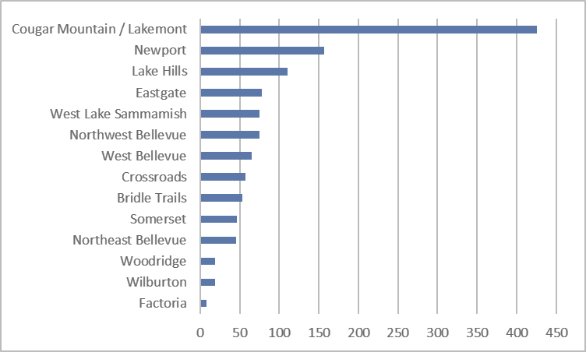
New Residences –
Undeveloped Land
.
Notes:
Based on new single family permits, 2000 – present
1,236 permits issued and closed
Caution them that this is raw data only. We went a step further and related the amount of development to the land area. We needed a base to compare ‘apples to apples’.
Let’s take one example. Locate Crossroads on the chart and then Eastgate. Crossroads only had 57 new residential units on vacant land (greenfield development) compared to say Eastgate, which had 78 new units. But Eastgate has twice the land area than Crossroads (1,761 acres vs 812 acres) so this growth impact is deemed to be greater on Crossroads.
Top 3 impacted neighborhood areas by new residences on undeveloped land as a ratio to land area = 1) Cougar Mountain/Lakemont; 2) Newport; 3) Crossroads
Before advancing to next slide, ask ‘which neighborhood had the most new infill residences (combined demolition and new building permit)?

Slide 15
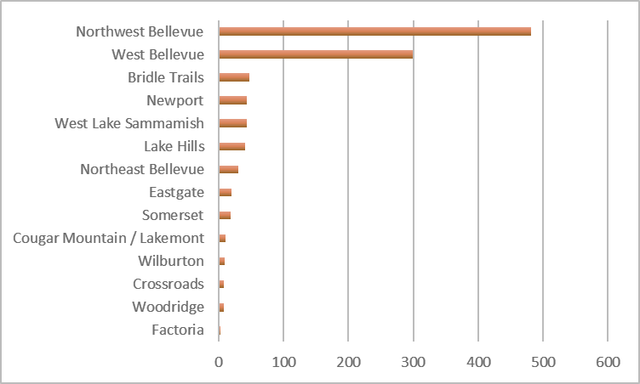
New Residences –
Infill Development
.
Based on combined demolition and building permits, 2000 – present
1,060 permits issued and closed
Notes:
Based on combined demolition and building permits, 2000 – present
1,060 permits issued and closed
Top 3 impacted neighborhood areas by new residences infill as a ratio to land area = 1) Northwest Bellevue; 2) West Bellevue; 3) West Lake Sammamish
Before advancing to next slide, ask ‘which neighborhood had the most new commercial and multi-family growth (in square footage)?

Slide 16
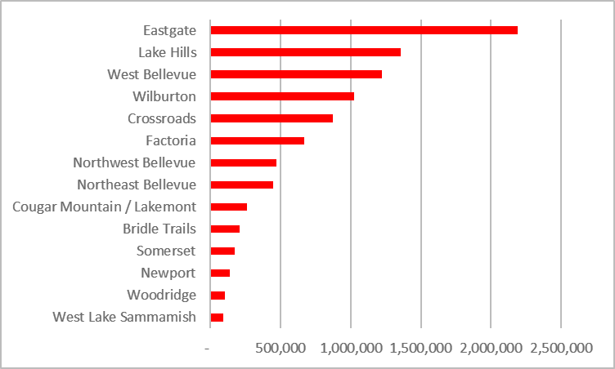
Multifamily &
Commercial Development
.
Notes:
Based on multifamily and commercial building permits, 2001 – present
Over 9 million sq ft of development
Top 3 impacted neighborhood areas by multi-family and commercial land to land area = 1) Factoria; 2) Eastgate; 3) Crossroads

Slide 17
Findings
Highest ranked areas:
Northwest Bellevue
Crossroads
Lake Hills
West Lake Sammamish
Notes:
When we sum totaled the rankings for all 4 variables, here is the list of the 4 overall top ranked neighborhood areas.
Mayor would like us to discuss whether the rankings reflect a geographic equity in the distribution of neighborhoods throughout the city.

Slide 18
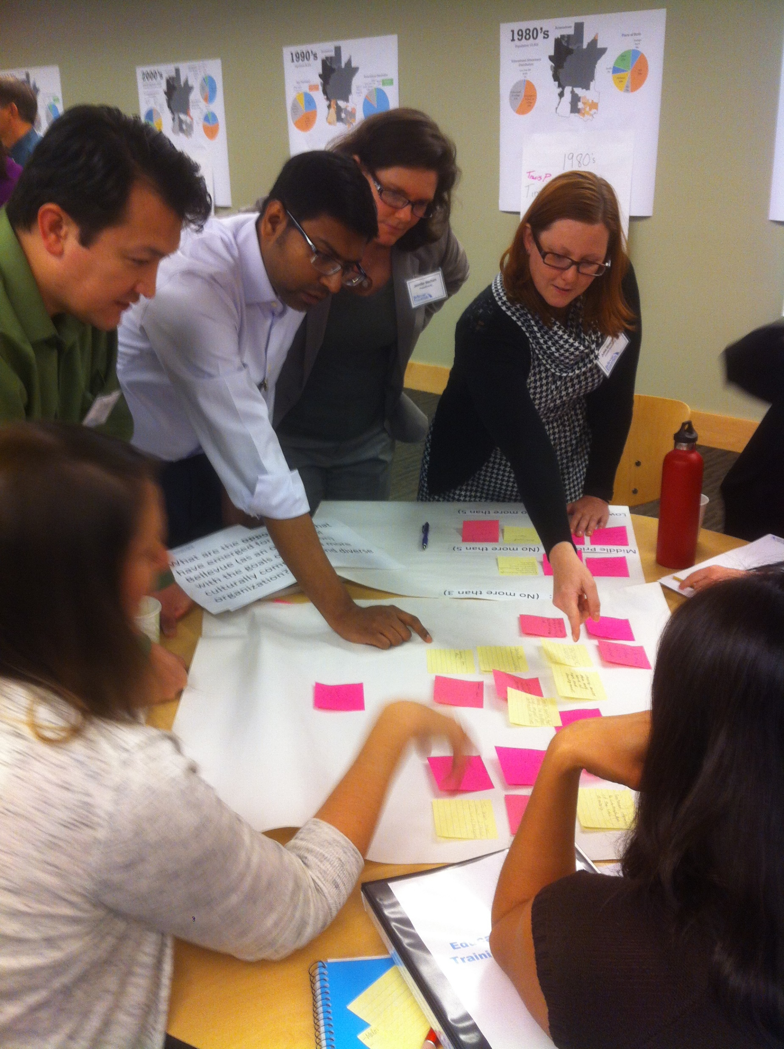
Potential Additional Factor
The rapid growth in adjacent jurisdictions impacts many Bellevue neighborhood areas.
This may be worth considering when sequencing the plans.

Slide 19
Potential Additional Factor
Neighborhood areas experiencing these impacts, particularly:
Northeast Bellevue, Crossroads
(impacted by growth in Redmond)
Newport (impacted by growth in Newcastle)
Notes:
We brought this forward because this is an externality we couldn’t account for in the analysis but it does have significant impact on our neighborhoods.
Redmond
Microsoft will be adding 2.5 million square feet more office space, renovate another 6.7 million square feet and add 8,000 more employees to its 47,000 employee base there.
Seritage (Sears Plaza)
Newcastle
Newcastle Commons (Avalon Bay) 900 units
I-405 widening (date unknown)

Slide 20
Option 1 - ACTion
Initiate comprehensive plan amendments for preparation of the:
Northwest Bellevue and Crossroads neighborhood area plans in 2018/2019, and
Lake Hills and West Lake Sammamish neighborhood area plans in 2019/2020.
Notes:
Neighborhood areas plans will be adopted as an amendment to the Comprehensive Plan.
This is simply the top 4 neighborhoods from the initial ranking. It doesn’t include the additional consideration of the growth in surrounding jurisdictions.
Pro
This option gives some certainty to 4 neighborhoods that neighborhood planning will be coming within 2 years.

Slide 21
Option 2 - action
Initiate comprehensive plan amendments for preparation of the:
Northwest Bellevue and Crossroads neighborhood area plans in 2018/2019, and
Direct staff to return in 2019 with updated ranking information incl. growth from surrounding cities for Council to consider before initiating 2019/2020 plans.
Notes:
Pro
This option gives Council certainty to 2 neighborhoods that neighborhood planning will start this year, see how it’s working for those neighborhoods and then make the decisions for the next 2 (or 4) sometime in 2019.
Or, Council could provide an alternate direction to staff.

Slide 22
REcommendation
Option 1 – Initiate plan amendments for 4 neighborhood area plans.
2018/2019: Northwest Bellevue and Crossroads
2019/2020: Lake Hills and West Lake Sammamish

Slide 23
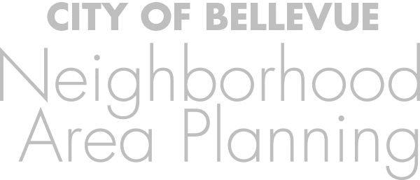
PLAN SEQUENCING
Mac Cummins
Terry Cullen
August 6, 2018

